Slide 1
Level 6 Group 3 : Pitch Two
Presented on 08/11/2017
River Chick
Michael Curtis
Ryan Manthorp
Ogheneochuko Ideh

Slide 2
Specifications
Projected Demographic 16+ Casual & Achieving Players
Genre Managerial Idle Game
Platform Android, IOS (stretch goal)

Slide 3
Prototype
Video Here

Slide 4
Habitual Loop Hook model
Trigger
Action
Reward
Investment

Slide 5
Emotions
Serious Fun
Social Fun
Achievers
Habits of Character

Slide 6
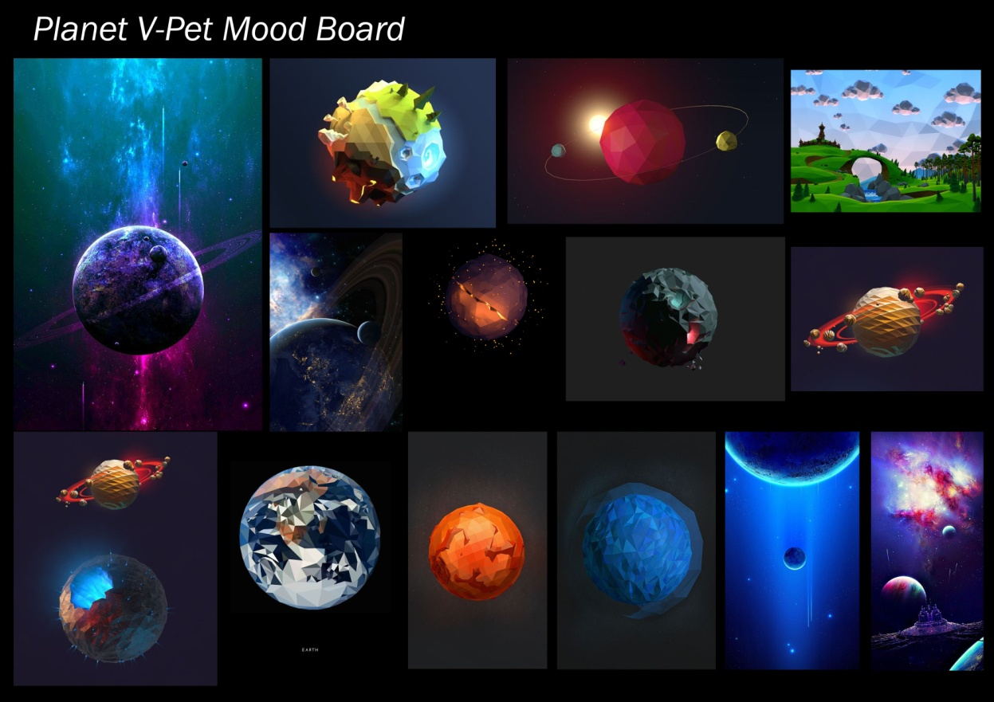
Art Style
Low poly : optimised for mobile platforms.
Stylized flat colours : more effective with low poly.
Hemisphere 3D models.

Slide 7
Monetization
Gacha Mechanic Random reward given on faith spend Rewards can be purchased for real money
Gamplay Enhancing Rewards Expensive & Rare
Customisation Cheaper & Common

Slide 8
Incoming Features
Leaderboard - Monthly/Weekly
Magnifying Window
IOS
Vanity Items

